Slide 1


FRAUDULENT PRESCRIBERS – OPIOID TRENDS
Nishi Thorlapati
Date: 5/9/2022
HF/LGACC DA Program

Slide 2




MOTIVATION AND GOAL
Huge volume of fraudulent claims – Constituting Opioids involvement
In line with my current role at HF
DATA SOURCE:
CMS – 2019
Contains detailed summary of Prescribers/Providers
Notes:
Drug overdose deaths involving psychostimulants such as methamphetamine are increasing with synthetic opioid involvement.
Especially here in my current role at HealthFirst, I must work with large clinical claims datasets for various nuances and one such important factor is Opiate usage and other topics related to clinical Fraud, Waste and Abuse (FWA) which are really analytic in nature. This is a wonderful opportunity to work on something that brings more value to my role at HF. I have selected the dataset that has scope for analysis on Fraudulent Prescriber trends and hopefully vital information on opioids. I believe this will help me in applying the knowledge gained through this DA course to real time issues at hand.
The dataset I would be working on for this capstone project is from CMS and contains detailed summary of Prescribers/Providers in the CMS system and their corresponding claims details by geography and type of drugs.

Slide 3


Methodology:
Python for initial Data preprocess, statistical and exploratory analysis and few visualizations
Tableau for in depth visualizations and dashboard
Notes:
I have used python to pre process the data set that i am using. I cleaned it to remove any nulls and checked for datatypes as well. The statistical analysis portion from python has also been presented in tableau. I have chosen the columns that are vital for my analysis. researched the ratios, grouped data using clusters. I downloaded this cleaned dataset to CSV and used the same file in Tableau for my further analysis.

Slide 4
Questions I am tackling with this analysis:
1. Prescribers and their respective claims by location
2. Trends in Prescriber types
3. Anomalies in No of patients Vs Opioid Drugs (lower the number of patients, higher the cost.. hmm..suspicious!)
4. Main goal is to find out fraudulent behavior by NPI’s

Slide 5
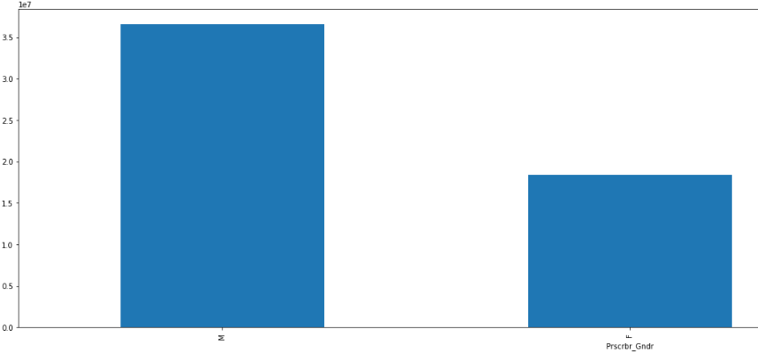
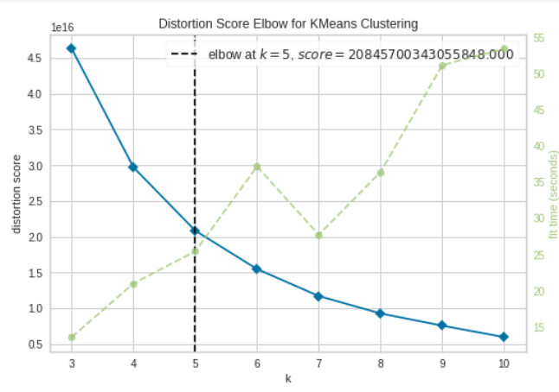
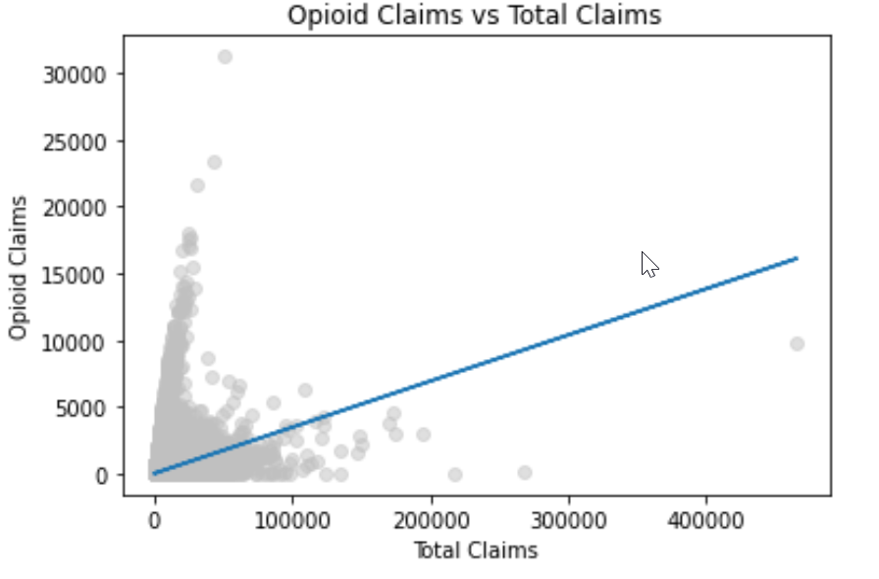
Analysis using Python:
Male prescribers with higher rate of Opioid claims
Very useful for cleaning my dataset
Statistical information like % of opioid claims Vs Total claims
Few charts to understand how the data is trending
Clustering data based on type of claims and associated cost
Prescriber trend by gender when it comes to opioid claims
Notes:
Few snags like the scatter plot, cannot really show any of the labels that I wanted…

Slide 6
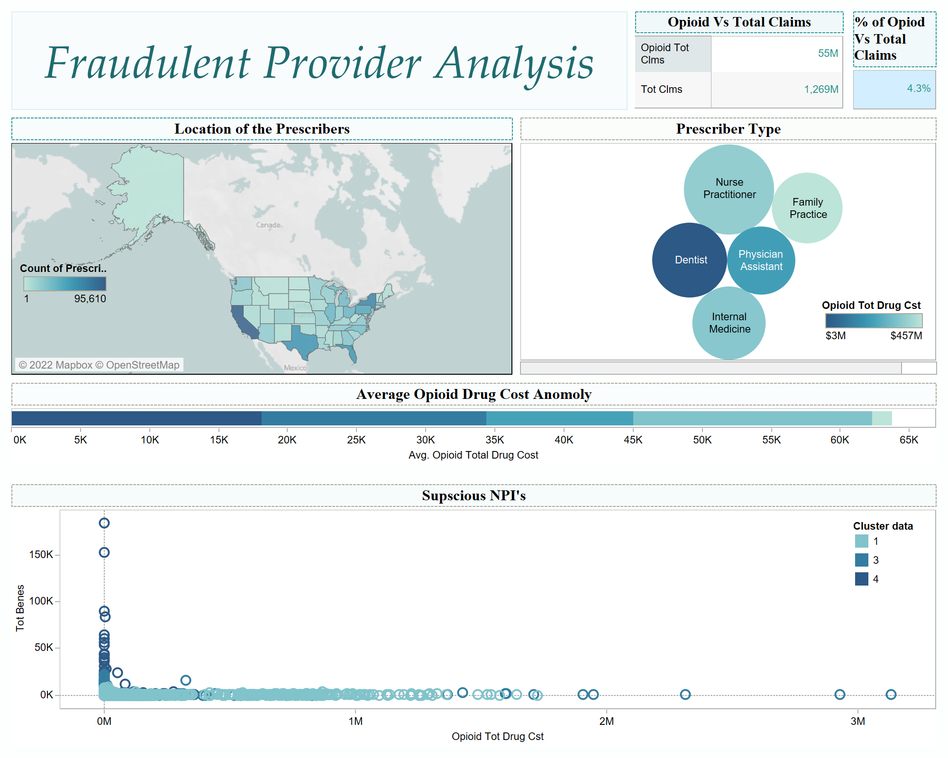
Analysis using Tableau

Slide 7
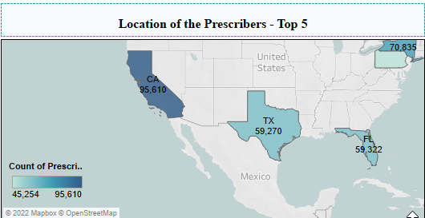
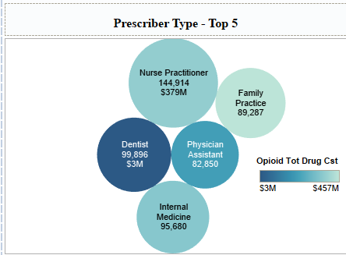
Top 5 states and Prescriber Types- High NPI counts and $ associated
Top 5 States with high count of Prescribers
Top 5 Prescriber specialties with high count of Prescribers

Slide 8
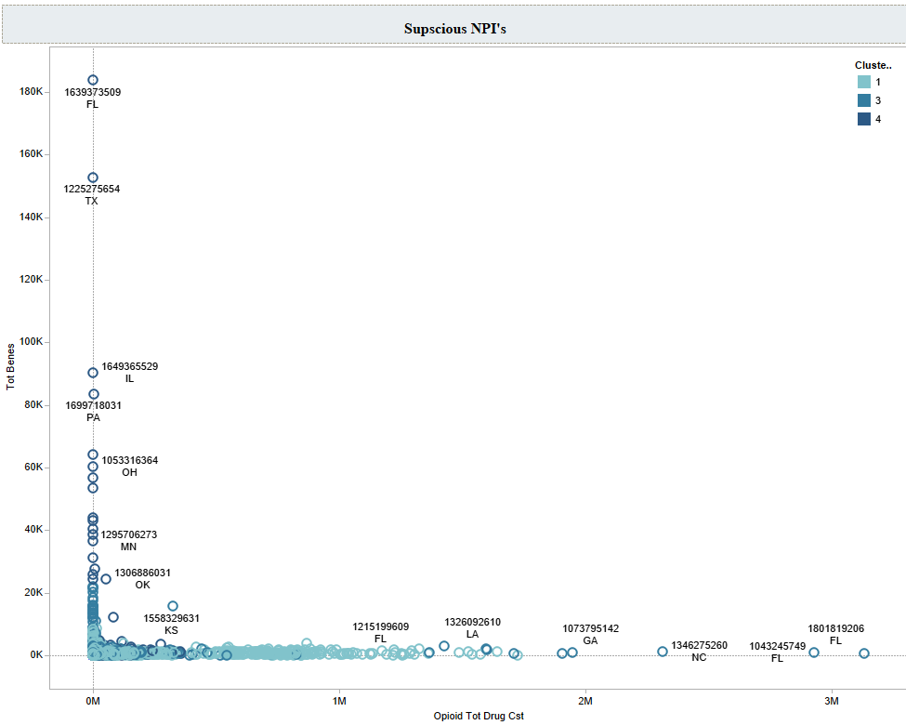
Tableau Dashboard
Average Opioid Drug Cost Anomaly:
Grouped Data based on Average Total Patients and Average Total Opioid Drug cost
Lower the No. of patients, higher the associated Opioid Drug cost calls for further research on the particular groups of data
Suspicious NPI’s:
Further analysis on cluster 1,3 and
Prescribers falling after $1.5 to $2M can be associated with fraudulent opioid activities
Prescriber NPI and State

Slide 9

Summary:
Findings:
Able to pinpoint Prescribers with suspicious prescribing patterns
Observations on prescriber types
Takeaways:
Oversight related to opioid usage to curb this epidemic
Extra laws to be implemented like few codes that help limit this pattern pertaining to prescriber types
Such exploratory analysis is very vital
Notes:
expected to see Cardiology or emergency medicines to have higher rates of opioid usage but Nurse practitioners have the highest range

Slide 10
References
Data source: Medicare Part D Prescribers - by Provider - Centers for Medicare & Medicaid Services Data (cms.gov)
Opioids information: Continuing Progress in the Fight against the Opioid Crisis | CMS
Clusters: Elbow Method for optimal value of k in KMeans – GeeksforGeeks K Means Clustering | K Means Clustering Algorithm in Machine Learning (analyticsvidhya.com) https://www.scikit-yb.org/en/latest/api/cluster/elbow.html

